Slide 1
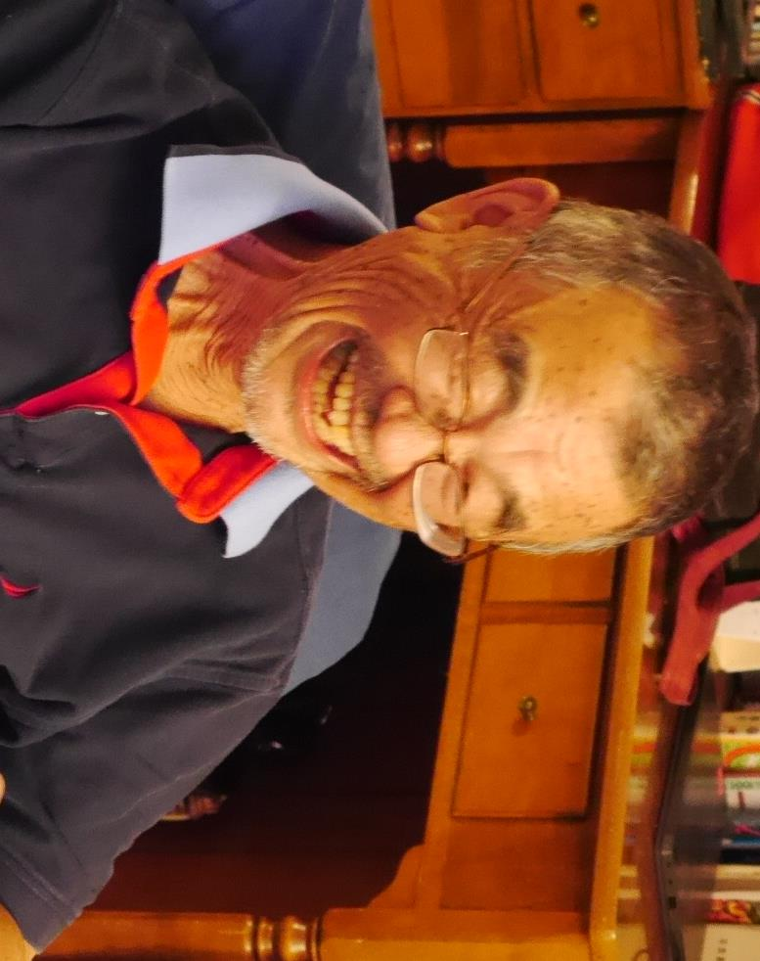
Memorial Service for Yuki Mizuta
水田幸直さん
召天記念礼拝
Rev. Kevin Clouse
Rev. Fumihito Andy Nakajima

Slide 2
Rev. Kevin Clouse ケビン・クラウス牧師
Matthew（マタイ）11:28-29
「すべて、疲れた人、重荷を負っている人は、わたし（イエス）のところに来なさい。わたしがあなたがたを休ませてあげます。わたしは心優しく、へりくだっているから、あなた方もわたしのくびきを負って、わたしから学びなさい。そうすれば魂に安らぎが来ます。」
Romans（ローマ人への手紙）15:13
「どうか望みの神があなた方を、信仰による全ての喜びと平和をもって満たし、聖霊の力によって望みに溢れさせてくださいますように。」

Slide 3
Statement of Purpose:
今日、私たちが集まっているのは、友であり、夫であり、父であり、兄弟である水田幸直さんの人生を神様に感謝するためです。
ともに痛みと悲しみを共有し、恵みを豊かに賜る神様を見上げ、慰めを受け、悲しみの中にも復活の希望を見るためです。
イエス様は、ご自分の命を捧げることによって、死を打ち破り、復活により、私達の命をよみがえらせたのです。 洗礼により、ユキさんは聖霊の証印を受け、キリストにある者として永遠に認められたのです。
そして、私達はここに集まり、ユキさんの人生に感謝を捧げるとともに、ユキさんと私達への神様の豊かな愛に感謝し、互いに支え合うためでもあります。
では、祈りましょう。

Slide 4
Speech: Yoshio Shibazaki 柴崎芳生さん

Slide 5
My name is Yoshi Shibazaki. Currently, I am elder at Cornerstone Evangelical Free Church. Today is to celebrate and reflect Yuki san’s life. I met Yuki san 34 years ago. As I reflect Yuki san, I recently discovered something new. Few weeks ago, Takako san called me. “Yoshi, can you come to our house? I am looking for someone like you with short legs. I want to give you Yuki’s clothes. That time, I thought to myself, “My legs are longer than Yuki’s !! ”

Slide 6
As it turned out, when I wore his jacket and pant, they exactly fit to my body; i.e., length of his jacket and waist and legs of his pant. As Takako san expected, I have shot legs exactly like Yuki’s. Everyone, don’t you think these fit exactly to me? This past several weeks, every time I wore Yuki san’s jacket and pant, it is reminded that Yuki san is in heaven with Christ in complete peace. In the Bible, we were taught to put off your old self not knowing Jesus Christ, and to put on the new self-giving by Jesus Christ, created to be like God in true righteousness and holiness.

Slide 7
When I describe Yuki san in one phrase, I can call him “The father of Japanese mission in the Midwest.” I am sure that many of you is thinking him as “The father of Japanese mission in the Midwest. Personally, I was very close to Yuki san. He was my first boss at the accounting firm back in 1988; later, he was my client. Along with Takako san, he acted as a match maker for Yoshi and Emi. Yuki san and Takako san came to our engagement ceremony in Osaka as well as our wedding back in 1994. As such, Yuki san is “my father in the US.” I am very thankful.

Slide 8
At the end of the last year, I had a chance to talk to Yuki san. He told me two things. First, he told me that he is very thankful that Yuko, Ken and Nao have wonderful families. Second, he told me that he would have never become a Christian unless he had not come to Chicago. Yuki-san is now alive in the presence of the Father and the Son in heaven. We thank God that we are blessed to be able to walk with hope.

Slide 9
In the end, let me read from the Bible and pray. 「神は、実に、そのひとり子をお与えになったほどに、世を愛された。それは御子を信じる者が、一人として滅びることなく、永遠のいのちを持つためである。」 “For God so loved the world that he gave his one and only Son, that whoever believes in him shall not perish but have eternal life.” Let’s pray.

Slide 10
Our Father, who art in heaven. We thank you that we can call you "Our Father" through Jesus Christ anytime and anywhere. Today, we thank God from the bottom of our heart as we reflect on the many wonderful ways you had worked through Yuki san's life as a "father on earth.” We express our heartfelt gratitude to you for Yuki san that he met Jesus Christ, the only begotten Son of God, in Chicago, repented of his sins before God, had his sins forgiven through the cross of Jesus Christ, was given eternal life, and is still living in heaven. May God help many of Yuki san’s friends who do not know you to get to know you personally through the Spirit of God. We express our heartfelt gratitude to God for meeting our various "needs" through Yuki san. We express our sincere gratitude to God that you had worked through Yuki san to protect many of our friends from falling into evil. We pray in Jesus’ name, Amen.

Slide 11
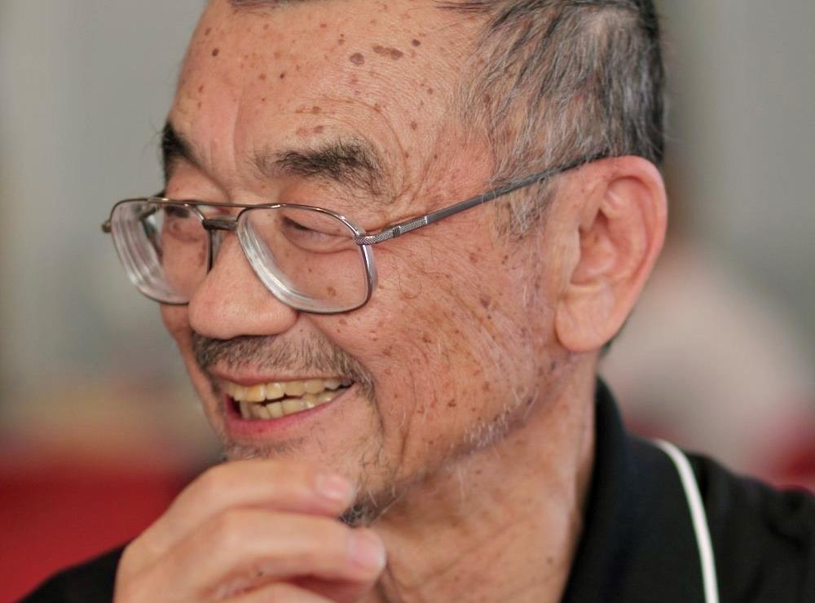

Slide 12
Speech: Kiyoko Sturtevant スタートバント・希世子さん

Slide 13
I first met Yuki-san in the summer of 1999. I started living in the town of Kalamazoo with my husband and two roommates who got jobs at the same time from the same university. When I started my newlywed life with my husband, I thought "I don't understand this man.” Thinking about how I could understand him better and his thought process, I thought it would be necessary to understand Christianity, which is the fundamental of his thinking as he was raised by the religion.
I asked an acquaintance from our college town, "I want to know about Christianity, but how can I learn more about it?” In response, my acquaintance said, "I have never met Mr. and Mrs. Mizuta, but it seems that they are doing a Japanese Bible study in Battle Creek. It’s close by to where you live, so I will contact them for you."

Slide 14
A few days later, Mrs. Takako Mizuta called me and invited me to participate in the Bible study at their house.
My husband and roommates would carpool to save money and left home at 5:30 am every day to work at the Battle Creek office from the neighboring city of Kalamazoo. I asked if I could ride with them and then be dropped off on the way to work. There were no GPS 23 years ago, so Yuki-san would pick me up at the parking lot of a supermarket called Meijer in Battle Creek at 6 o'clock in the morning.

Slide 15
On the day I was supposed to attend the Bible study, I was dropped off in front of the entrance of Meijer. Soon, a car stopped in a parking lot where only a few cars were parked. A Japanese man was walking toward me with a smile.
I returned the smile while I waited, thinking "Is that person Mr. Mizuta?" When we got closer to each other, the man asked, "Are you Yuko?" My name is Kiyoko, so I responded quickly, "No, I'm not!" And the man said, "Oh, excuse me." After that, for a while, the two of us stood on this side and the other side of the Meijer’s door, looking at the large parking lot without exchanging words. While standing together in silence, it was quite awkward.

Slide 16
While looking at the parking lot in the white light of the morning, I thought to myself, "Wait a minute, there are two Japanese people who happen to meet at 6 o'clock in the parking lot of such a rural supermarket in the United States. Is that a coincidence?“
I didn’t think so, but being a shy person, I wasn’t sure what to say to him, especially after denying that I was the person he was looking for. A few minutes later, I plucked up my courage to approach him, and I asked him, "Ah, are you Mr. Mizuta? Ah, my name is Kiyoko." He said, "I wonder if I remembered the wrong name. I thought it was strange." We laughed about it.

Slide 17
From that day on, every week for the Bible study, I stayed at the Mizuta residence after being dropped off at 6 o'clock in the morning, and I just relaxed on the sofa in the living room and waited for them to come down.
I have been attending the same Bible study for over 20 years and the Mizutas have been watching the growth of our four children.

Slide 18
I always referred to Yuki-san as "the ideal husband,” because of his acts of kindness.
There were many days when it snowed in the morning during the Bible study. After the Bible study, we all enjoyed having lunch at the potluck, chatting a lot. When we would head to our cars to go home, Yuki-san always removed the snow around each car.
This is because of Mr. Yuki's consideration to prevent all cars from being stuck in the snow. He didn't say a word about it. He always just did it. I felt the love Yuki-san had for everyone.

Slide 19
The last time I was able to talk with Yuki-san was a few days before he stayed in the ICU. I had a little errand and had the opportunity to talk on Zoom with him.
He seemed to have a hard time speaking, but he was still smiling all the time. When I was about to end the zoom, Yuki-san jokingly said, "Kiyoko-chan, everyone looks pleased because I don't speak too much." I replied, “Oh, you can't say all the old man jokes you love. It's unreasonably painful for you, isn’t it?" and he laughed with his silent voice. I still remember his big smile.

Slide 20
Even after he joined the ICU, I was talking to him in my heart, "Yuki-san. Yuki-san, can you hear me?" while thinking of his smile.
I think many people in here can still hear Yuki-san's voice calling their name along with his smile.
I am grateful to have met Yuki-san and was so lucky to feel his large capacity of love. Thank you.

Slide 21
John（ヨハネ）11:25-26
イエスは言われた。「わたしは、よみがえりです。いのちです。わたしを信じる者は、死んでも生きるのです。また、生きていてわたしを信じる者は、決して死ぬことがありません。このことを信じますか。」
Revelation（黙示録）21:3-5a
そのとき私は、御座から出る大きな声がこう言うのを聞いた。「見よ。神の幕屋が人とともにある。神は彼らとともに住み、彼らはその民となる。また、神ご自身が彼らとともにおられて、彼らの目の涙をすっかり拭い取ってくださる。もはや死もなく、悲しみ、叫び、苦しみもない。なぜなら以前のものが、もはや過ぎ去ったからである。」
すると御座に着いておられる方が言われた。「見よ。わたしは、すべてを新しくする。」

Slide 22
Hymn: “Amazing Grace” (verses 1-2 in Japanese and verses 3-4 in English)
1. 驚くばかりの 恵みなりき Odoroku bakari no megumi nariki この身の けがれを 知れる我に Kono mi no kegare o shireru ware ni 2. 御国に 着く朝 いよよ高く Mikuni ni tsuku asa iyoyo takaku 恵みのみ神を たたえまつらん Megumi no mikami o tatae matsuran

Slide 23
3. Amazing grace! How sweet the sound That saved a wretch like me!
I once was lost but now am found, Was blind, but now I see!
4. When we’ve been there ten thousand years, Bright shining as the sun, We’ve no less days to sing God’s praise Than when we’d first begun.

Slide 24
Speech: Gerda Vanstralen ゲルダ・バンストラーレンさん

Slide 25
私たちは、水田幸直さん（ユキさん）とのお別れのために集まっています。
ずっと「グッドバイ」という言葉の意味について考えてきました。「バイ」という言葉は、B-Y-Eという古期英語で「時間が決まっていない」ことを表しているそうです。
私たちが誰かに「グッドバイ」と言う時、その別れが、不特定の時間となることを認めるということだそうです。
ユキさんは不特定の時間、私達の元から連れ去られました。彼の死は、私たちに多大な悲しみをもたらしました。いったいこの「bye」に、何の「good」があるのでしょうか？

Slide 26
ユキさんの人生を振り返ると、この辛く苦しい体験の中でも、何か良いところが見つかるのではないかと思いました。
私たちは、ユキさんのたくさんの良い資質を思い出すことができます。何よりも第一に、多嘉子さんをこよなく愛する夫であったことです。お二人は、結婚生活と奉仕のパートナーとして何と麗しい関係を築いたことでしょうか。私はお二人ほど完全に調和した夫婦を見たことがありません。
ユキさんは親切で、寛大で、溢れんばかりのホスピタリティを持った素晴らしいご主人でした。楽しく、いつも冗談を言って、私たちを笑わせてくれました。同時に、非常に知的な人でもありました。哲学的な深い事柄について話すのも好きでした。
そして、無私の人でした。何度も言わせていただきたいほど本当に無私な人でした。私たちに無私の心で人に仕えたいと思わせてくれるような素晴らしい人格者でした.

Slide 27
ユキさんはたくさんの善いことしてくれました。いつでも、どこでも、誰でも、助けの手を差し延べない人はいませんでした。ユキさんにとっては、どんな依頼も大き過ぎず、小さ過ぎず、何でも引き受けてくれました。教会で、日本人学校で、日本人コミュニティーで、日本語礼拝で、サマーキャンプで、ウェスタンミシガン大学で毎月開催されるインターナショナル・ランチョンなど様々な所で、心を砕き、思慮をもってリーダーシップを発揮し、参加してくれました。また、通訳でも翻訳でも、優れた英語力を駆使して、助けてくれました。それは、ユキさんが心から人々を愛していたからだと思います。

Slide 28
様々な人を招いてダイニングテーブルを囲み、食事や交友を楽しむだけでなく、運転でもその愛を示してくれました。様々な人のためにミシガン州やイリノイ州をくまなく走り、信じられないような数のイベントや会場に連れて行ってくれました。
車のない学生がいると、学校、駅、空港まで送迎してくれました。まるで無料のタクシーサービスをしているかのようでした。また、泊まるところが必要な人がいれば、快く自宅を開放してくれました。 彼のしてくれた善いことを全て挙げることはできませんが、今度は私たち一人ひとりが何らかの形で、ユキさんがしてくれたことを続けることはできると信じています。

Slide 29
何よりも、ユキさんは心の底から善い人でした。「自分はこんなにたくさん善いことをしたから善人だ」なんて、もちろんユキさんは思ってもいないはずです。ユキさんには、イエス様が自分の罪のためにも命を捧げてくださったという深い信仰がありました。イエス様のお蔭で、神様と正しい間柄に置かれたと信じていました。自分が変えられたことが分かっていました。そして、ユキさんは私たちにも、神様からの善を受け取ってほしいと願っていると思います。
これが、ユキさんが私たちに教えてくれた「グッドな bye」だと思います。そして最も大事なことは、イエス様を信頼すれば、ユキさんと必ず再会できるということです。「Sweetなbye」の中でユキさんと再会ができるのです。その時、いつ終わるかわからない不特定な時間で会うのではなく、永遠に、永久に一緒にいることができるのです。

Slide 30
ユキさんのいない世界なんて考えられないと思うときも確かにあります。ユキさんは私たちの人生に、何ものにも代えがたい、誰にも代えがたい足跡を残してくれたからです。
ユキさんは、神様から私たちへの贈り物でした。とても、とても、良い贈り物でした。
しかし、ユキさんと天で再び会えるまで、私たちは進み続ける必要があります。良い思い出を胸に、この地上での期間はそれほど長くないと信じ、良い終りが待っているのだと確信しながらです。
ユキさんが示してくれた善いことを、受け継いで行こうではありませんか。

Slide 31
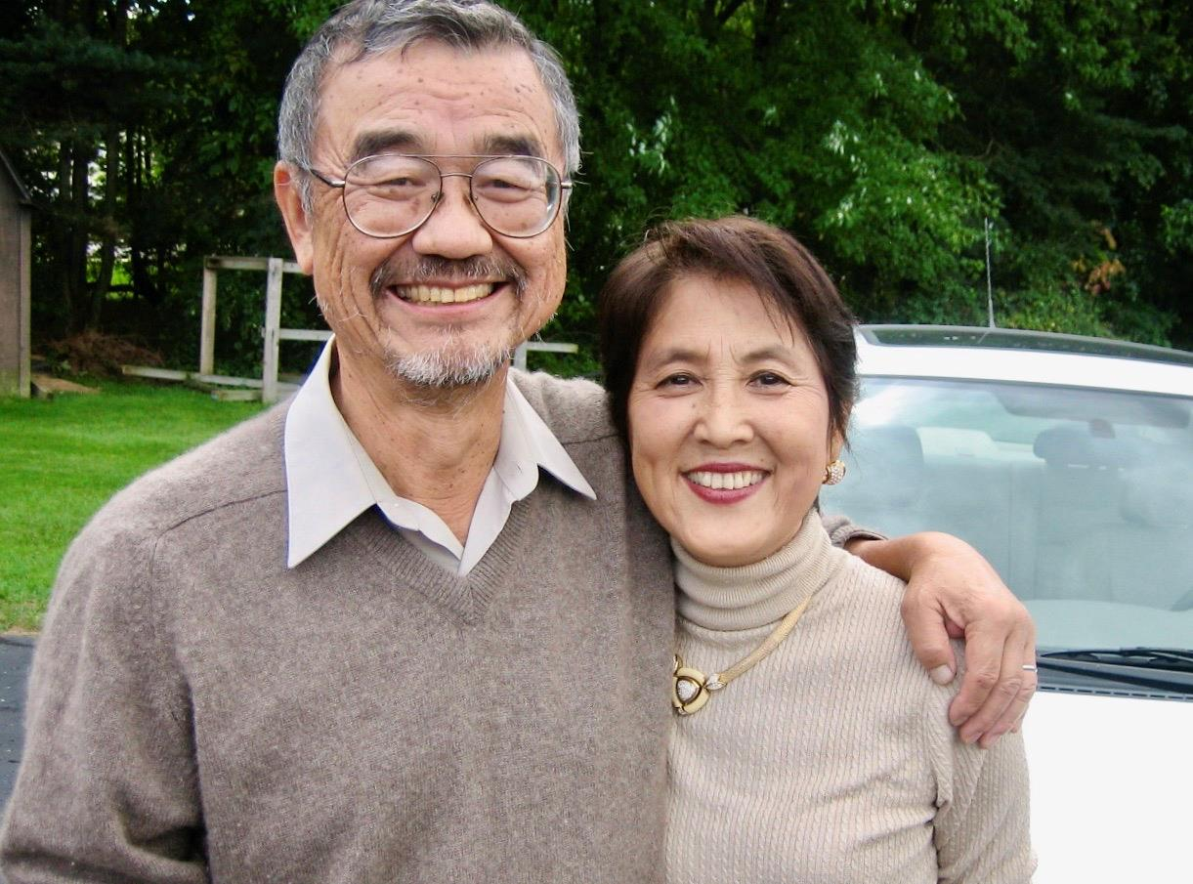

Slide 32
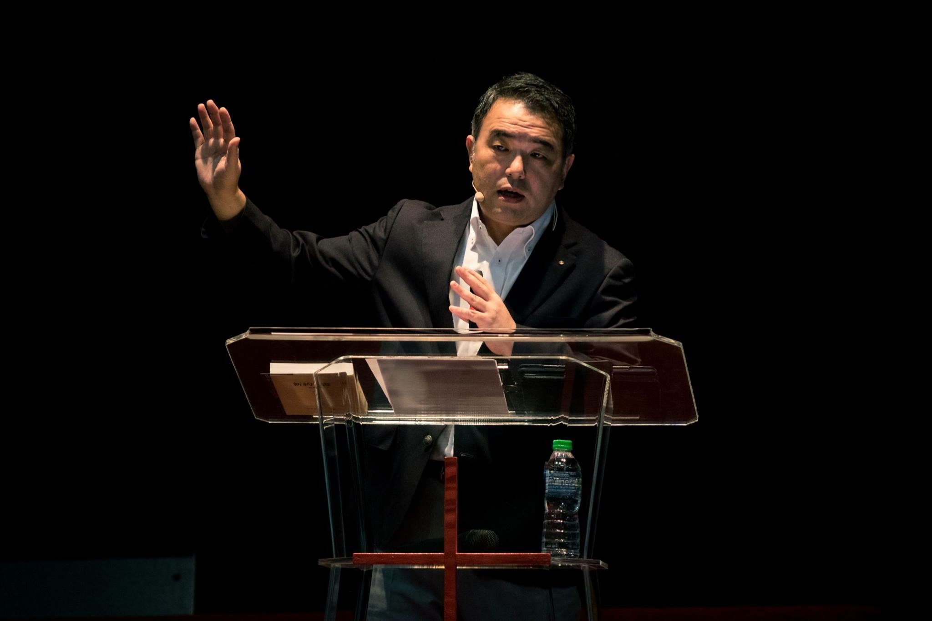
Speech: Rev. Ryosuke Iwahashi 岩橋竜介牧師

Slide 33
My name is Ryosuke Iwahashi. In January this year, I turned 57. By Japanese custom, I am myself the age to be referred to as “ojichan” (a general term for an older man in Japanese) but here, I will refer to our brother in Christ, Yuki Mizuta, like I always did with endearment, Ojichan, which is equivalent to referring to someone as “uncle”.
I attended Trinity Evangelical Divinity School in the suburb of Chicago from the fall of 1987 to early 1991, which is more than 30 years ago now. Just for reference, it was before the Bulls had their 3-peat championship, unfortunately…

Slide 34
At that time, most of the Japanese seminary students were already part of the Mizuta family and I also became an addition to the extended Mizuta clan. I’m sure everyone else there had the same experience as I did; the first time I walked into their home, they welcomed me like I had already been part of that home for years.
Actually, I myself grew up in a home just like that. My home was always filled with people from my church. Someone always joined us at meal times, as my parents welcomed anyone into our home like they were part of the family. Therefore, the Mizuta family literally felt like home to me, even more so.

Slide 35
If I were to share memories of Ojichan, it would be endless. As a pastor I’d talk too long as well. But, even among many memories, what comes to mind the most right now are not from extraordinary events. Instead, I fondly remember the dining table in the Winnetka house.
Memories I remember the most are ones where we all sat around at either their main dining table or smaller kitchen table to share a delicious meal that either Takako Obachan (term of endearment for older women, like “auntie”) whipped up or we all made together. They were all truly delicious and Ojichan would always say, “Ryosuke, will you pray for us?” which was a blessing as well.

Slide 36
As I mentioned, I am a pastor at Cross Place Church in Osaka. What we value at Cross Place above everything else is the service. In particular, the monthly communion ceremony where we remember the Lord’s supper is very important. When I participate in this celebration meal, what I imagine is not my own home, but it’s the Mizuta’s dining table. Perhaps it was because in Chicago, I was on the receiving end of being welcomed to the meal as opposed to hosting.
At communion, when we surround Jesus’ meal and partake in the bread and wine, I recall the joyous meals at the Mizuta’s. People who have never met from all over came together in that Winnetka house, welcomed by Ojichan and Takako Obachan and became part of the family. We would all comment, “This is so good” and eat meals together. Ojichan was always smiling at that table and shared lots of bad jokes that no one thought was funny. This was the everyday meal time at the Mizuta’s and this brought such joy, such comfort.

Slide 37
I will not hear Ojichan’s low and calm voice on this earth again. That is truly a deep loss for me. I would even take the bad jokes! But Ojichan has fallen asleep. He rests for a while in the peace of our beloved Lord Jesus Christ. This is not his final resting place though, as Jesus’ followers will hear God call their names and be resurrected.
He will hear God call, ”Yukinao, wake up” Those of us who believe in Jesus will also hear our names called. Then on that day, we will come again together at the Lord’s dining table where Jesus will be at the head of the table. It will be the banquet in heaven. I am looking forward to that occasion from the bottom of my heart. There, we will all be together again. I will see Ojichan and the Mizuta family! Every communion, I envision that hope of the banquet in heaven.

Slide 38
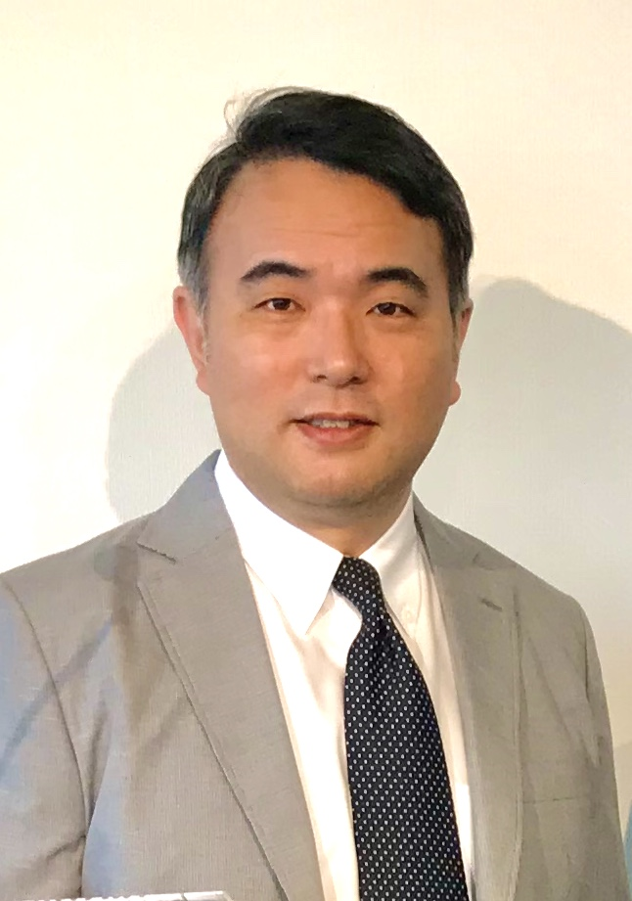
To Ojichan and Takako Obachan who included me as one of your sons, to Yuko, Kenichi, and Naoto, thank you so much. I am praying for all of you from Osaka.

Slide 39
Hymn: “What A Friend We Have in Jesus” verses 1-2: cantor and music only verses 3-4: congregational singing（会衆） 3. What a friend we have in Jesus, all our sins and griefs to bear! What a privilege to carry everything to God in prayer! O what peace we often forfeit, O what needless pain we bear, all because we do not carry everything to God in prayer!

Slide 40
4. いつくしみ深き 友なるイエスは
Itsukushimi fukaki tomo naru Iesu wa
罪 とが うれいを 取り去りたもう
Tsumi toga urei o torisari tamou
心の嘆きを 包まず 述べて
Kokoro no nageki o tsutsumazu nobete
などかは おろさぬ 負える 重荷を
Nadoka wa orosanu oeru omoni o

Slide 41

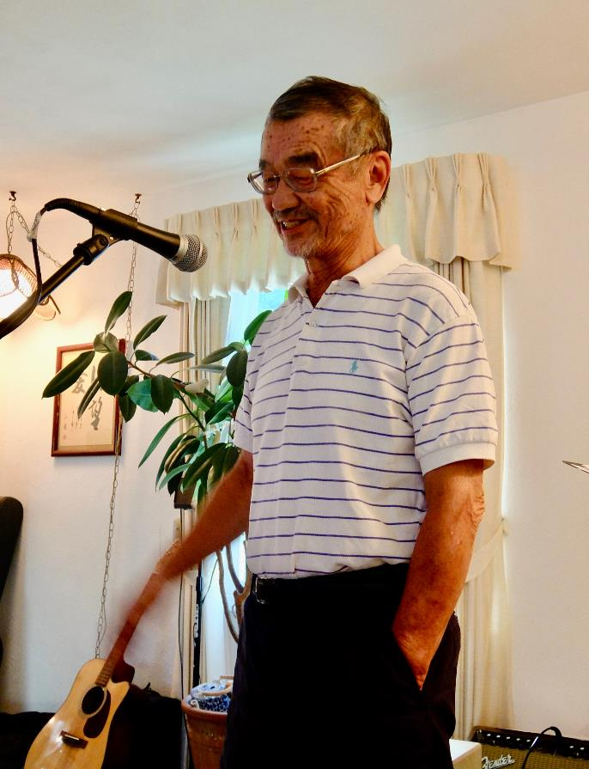
Audio: Yuki Mizuta (voice only) 水田幸直さん（音声のみ）
“Hello everyone! My name is Yuki Mizuta, and I just turned 70 years old on the 23rd of last month. In ages past, there was a special term for people who were seventy years old; “Koki,” which literally means “impossibly old.” If I lived in those ancient days, you might call me a living fossil! Thankfully, I’m not the only fossil here today, so I don’t feel entirely out of place. I know you have asked me here to give a testimony, but you should be warned: seventy years has given me a lot of stories to tell, so this may take a while! Of course, while that could be fun, I think it might be better if I just summarize and give you some of the highlights of my life instead…”

Slide 42
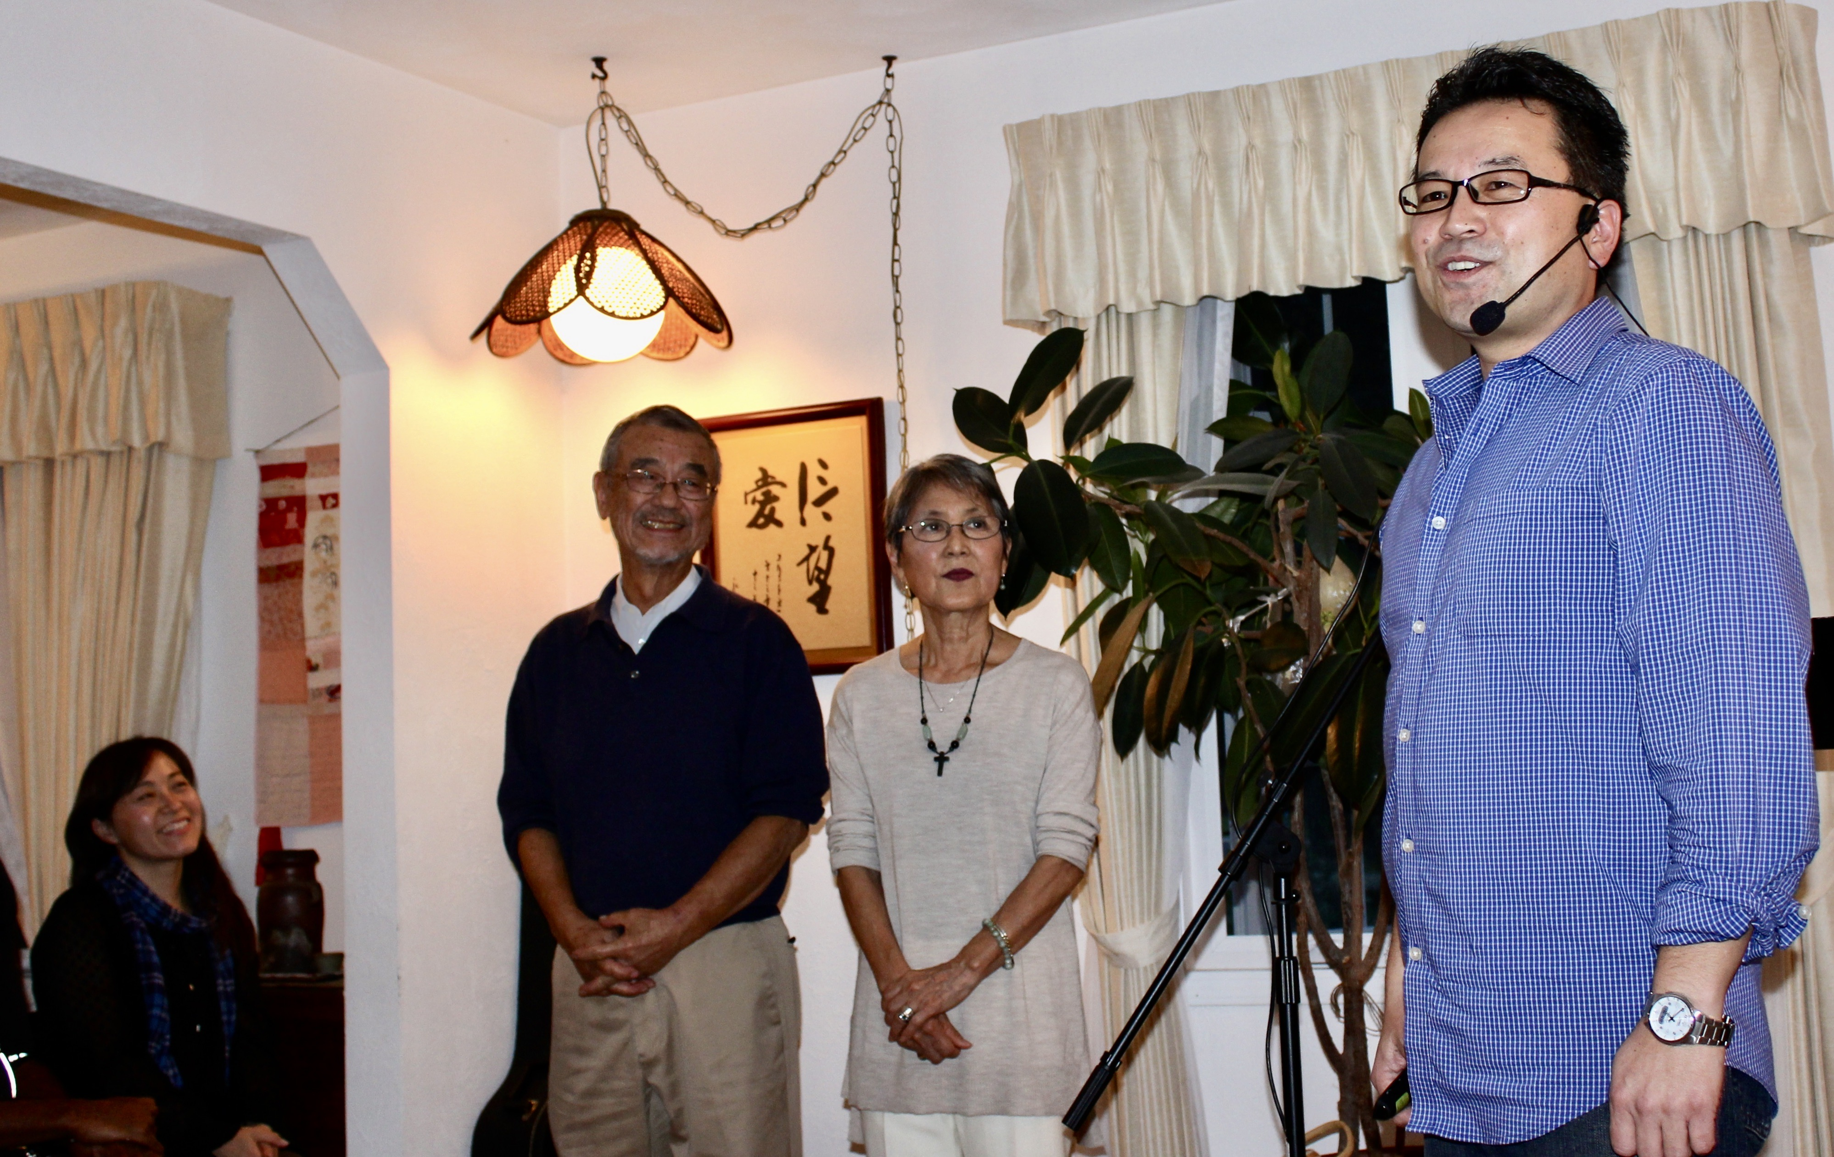
Rev. Fumihito Andy Nakajima 中嶋アンディ史人 牧師 注：ZOOMでの配信の関係上、 メッセージは音声のみでお繋ぎすることとなります。 ご了承ください。

Slide 43
As much as Yuki and Takako took care of many Japanese families in Chicago, they looked after countless people in Michigan by providing food and hospitality. So many of us were loved and helped by this incredibly kind couple. I am sure that each of you gathered here has wonderful memories to share of how much they accepted, encouraged, and loved you.

Slide 44
Someone once told me, "You can only understand what a person has really accomplished in life after they are gone.” After the news of Yuki's passing on January 26th, the grief spread like a wave across the US and Japan. Takako told us that many people sent their condolences and words of gratitude to her about Yuki. They all said that they remembered the fun and uplifting conversations, his big smiles, and the many laughs they shared.
Everyone felt loved and special with their hospitality. Yuki and Takako always made time for us, treating us with delicious food, and listening to us until late at night. We will treasure these memories and they will never fade.

Slide 45
As many of you expressed, Yuki-san was like a big brother, uncle, and father to us, and also a friend. One day, when Takako was talking with Yuki about his funeral in the distant future, he said, "At my funeral, I want people to sing ‘What A Friend We Have in Jesus.’” He loved, of course, his family, you, and his friends. But he knew the most important friend for him was Jesus, who changed his life and was with him always.
(The recording I played in the beginning contains his testimony. If you want the full recording, please contact me later.)

Slide 46
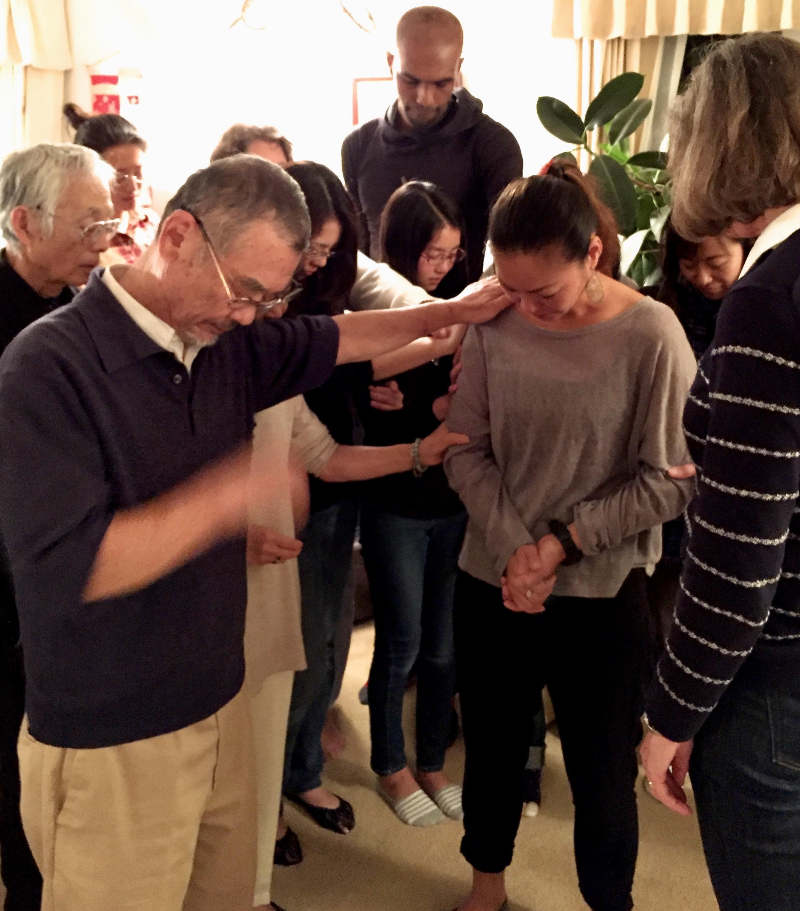
Yuki said that he first believed in Jesus because he was afraid of dying, but after he became a Christian, he did not fear death but rather looked forward to seeing Jesus. About 20 years ago, we were doing a men's Bible study and talking about what we would like to see written on our gravestones when we passed away. I remember Yuki saying, "He loved people. He loved God. And God loved him.” His life was exactly that.

Slide 47
One day, we all will return to heaven. We don't know if it will be when we are 80, 50, or 30 years old. Whichever age it is, it seems too short. But in John 14 and 15, Jesus reminded us that this world is only a temporary place, that He will eventually draw us to Himself, and that He has prepared a home for us in heaven. Yuki wanted to believe in him. When we look at Jesus, we see God.
Let me just read John 15:12-15. (When you have a chance, please read all of John 14-15.)

Slide 48
12 My command is this: Love each other as I have loved you.13 Greater love has no one than this: to lay down one’s life for one’s friends.14 You are my friends if you do what I command.15 I no longer call you servants, because a servant does not know his master’s business. Instead, I have called you friends, for everything that I learned from my Father I have made known to you. (John 15:12-15 NIV)
12 わたしのいましめは、これである。わたしがあなた方を愛したように、あなた方も互いに愛し合いなさい。13 人がその友のために自分の命を捨てること、これよりも大きな愛はない。14 あなた方にわたしが命じることを行うならば、あなた方はわたしの友である。15 わたしはもう、あなた方を僕とは呼ばない。僕は主人のしていることを知らないからである。わたしはあなた方を友と呼んだ。わたしの父から聞いたことを皆、あなた方に知らせたからである。（ヨハネ 15:12-15）

Slide 49
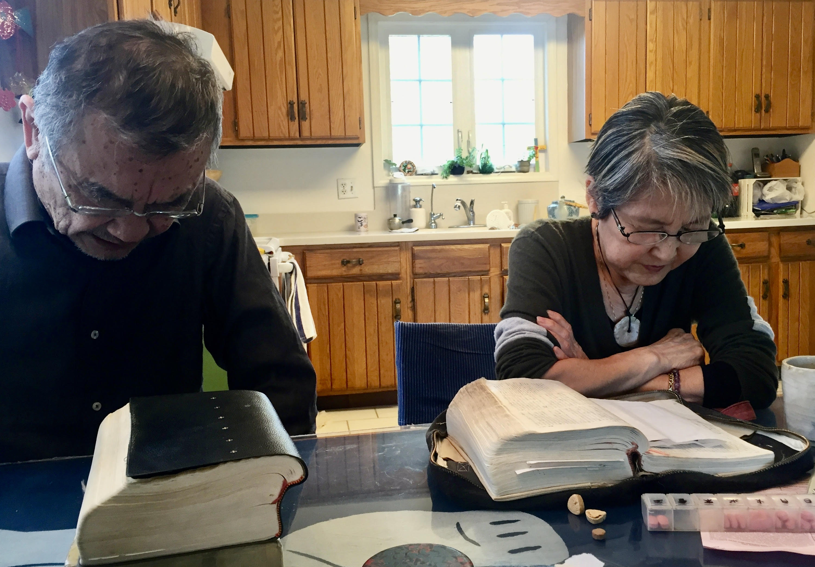
Yuki came to believe in Jesus Christ exactly 40 years ago. Every day in the morning, He and Takako read the Bible together, prayed, just like this picture, and welcomed us into their home so that they could be the reminders of God’s promises on this earth even while we are living in this difficult world. Yuki and Takako became the visible image of what Jesus Christ is like. How blessed we are to have known them both. Although we miss him, Yuki's heart has become a part of our hearts. And the love of Jesus who loved Yuki is also a part of us.

Slide 50
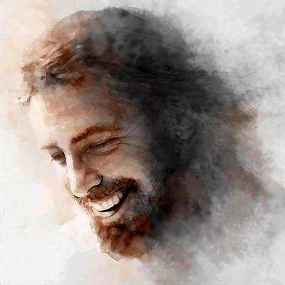
Sometimes I wonder how Yuki is doing in heaven now. I think he is probably talking and laughing with Jesus. I also think that his jokes are getting much better...
I also wonder what Yuki is wishing us from heaven. What do you think? Maybe, "Love God and love others." Maybe, “Take good care of Takako and my family.” And maybe the promise in the Bible, "Believe in the Lord Jesus, and you and your family will be saved. You will be in heaven with me someday....”

Slide 51
As pastors, Kevin and I always ask the bereaved, "How would you like your funeral to be?" For some families, they would prefer a quiet and solemn funeral. But some families ask for a funeral that is joyful, that makes them laugh, that enables them to have a clearer image of what heaven is like and what Jesus is like…

Slide 52
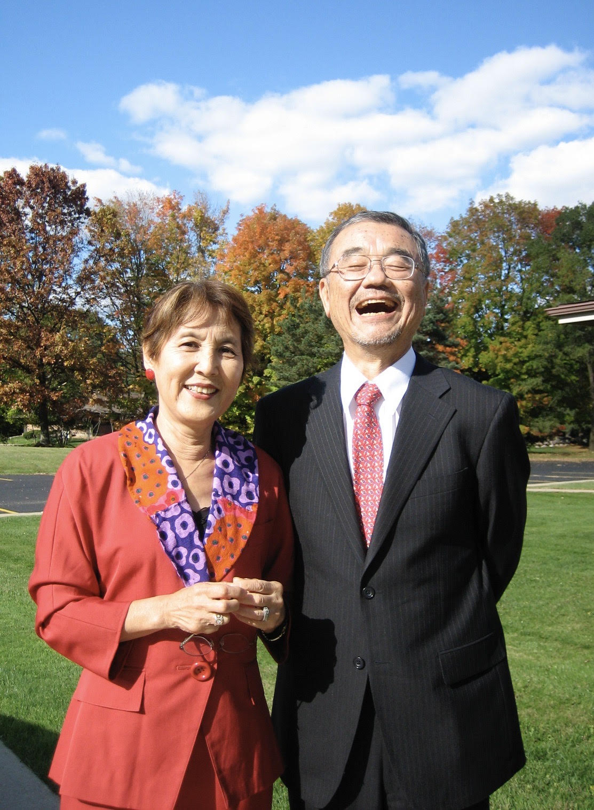
What you will find in heaven is gratitude, smiles, and love for God and others. Yuki is one step ahead of us, and he has embraced it. I'm getting more and more excited to go to heaven.
Thank you, Yuki. And thank you, Jesus, for letting us meet Yuki on earth. We look forward to seeing him again in heaven!

Slide 53
Speech: Kenichi Mizuta 水田健一さん

Slide 54
このような集まりでは、たいてい父が通訳することになっていました。ただ、父が通訳すると話が長くなることことがよくありました。元の話に自分の話を加えることが多く、一度に二つの話を聞くことになるのです。残念ながら本日は直訳のみで失礼いたします。

Slide 55
私の一番古い父との思い出は、ニュージャージーに住んでいた時のことです。私はまだ２、３歳で、前庭に座っていました。家の前には公園があり、父はゴルフのスイングを練習していました。父はゴルフが大好きで、時間があればゴルフをしていました。
ゴルフの後、家族で過ごす時間を作るため、よく朝早くからゴルフ場に行っていました。昨年は、家の近くのゴルフ場の会員になり、平日はほとんど毎日ゴルフに行き、時には２ラウンド回り、最高の夏を過ごすことができたようです。これも裕子とマークが父と母を迎え入れてくれたお陰です。両親と一緒に住む新しい家を見つけ、本当に歓迎してくれました。父は大好きなゴルフをしながら、母や姉の家族に囲まれて、心からリラックスできる毎日を過ごしていました。もっと長い間、この新しい生活を楽しんでもらいたかったのですが、姉とマークには本当に感謝しています。

Slide 56
父は、いわゆる「普通」のことをする人ではありませんでした。日本では、父の世代は生涯一つの会社で働くのが普通で、定年前に辞めることは珍しいことでした。父は、子供たちにとって、アメリカが一番いい環境だと信じ、当時勤めていた三菱銀行を辞めることを決めたと聞いています。今年になって父の当時の辞表を読む機会があり、それがどれ程大変なことだったのか初めてわかりました。辞表には、これからのグローバルな世界で子供たちが競争力をつけるために、米国での教育が重要であるが書かれていました。日本の銀行に籍を置きながらアメリカに残ることも考えたようですが、私たちにアメリカの会社で働く姿を見せたいという気持ちがあったようです。また、私たち子供が、日本にいた時よりシカゴに移ってからの方が生き生きとしていたと話していました。アメリカの会社での勤務は苦労もあったようですが、それがすべて私たちのためだったということを、十分に理解できていなかったように思います。いつも私たちのことを一番に考えていてくれたことに、改めて感謝の気持ちを伝えることができず残念です。

Slide 57
アメリカでの我が家の生活は少し変わっていました。大人になり、家を出て初めて、そのことに気付きました。というのも、中学、高校時代、我が家には頻繁に同居人がいたのです。また毎週日曜日には、教会の後に多くの方がいらして、家で食事をしていました。その方たちは、今でも実家に帰るとよく顔を合わせる親戚のような存在です。大勢で過ごす時間は、楽しくエネルギッシュで、愛にあふれていました。今、自分の家庭を持つようになり、多くの人を家に招く大変さを知りました。でも今振り返ってみると、両親が一方的にお客様をもてなしていたわけではないことに気付きました。家にいらした皆さんに、両親も支えられていたのです。

Slide 58
今まで、自分の育ったウィネトカが、両親にとってもホームタウンだと思っていましたが、Facebookで父にいただいた追悼コメントを読むと、実は両親はウィネトカよりもバトルクリークに長く住んでいたことがわかりました。バトルクリークでも、大勢の方々を家に迎え入れていたようです。私の両親を「アメリカのお父さん、お母さん」と表現する投稿を多くいただきました。父も母も、バトルクリークでもお互い支え合う大家族に囲まれていたのだと思います。
お集まりいただいた皆さんをはじめ、生前、多くの方々に親しくお付き合いいただいたこと、改めてお礼申し上げます。今後とも、変わらぬお付き合いをお願い申し上げます。

Slide 59
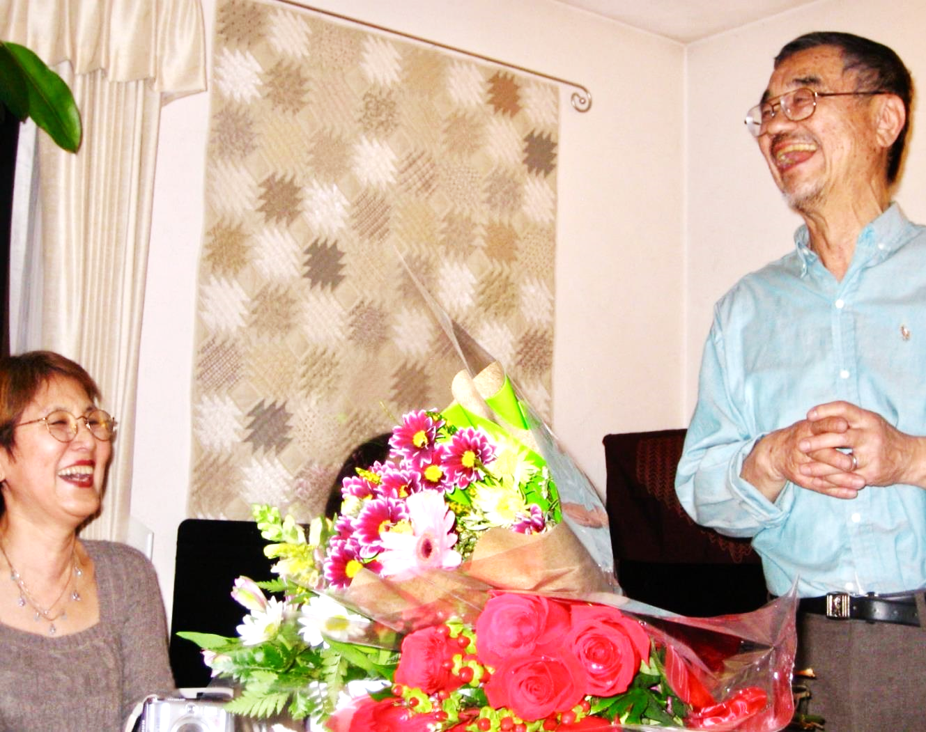
Presentation of the Mizuta family and remarks: Naoto Mizuta 水田直人さん

Slide 60
ここにおられるシカゴの皆さん、こんばんは。
そして、日本におられる皆さん、おはようございます。
私は水田幸直の末息子の直人と申します。
最初に私が代表して私の家族をご紹介します。姉の裕子と
その夫マークです。そしてその長男のTomoと娘の夏実。兄の健一と妻の亜紀子、そしてその長女Hanaと長男Kaiです。私の妻はChloeで、娘たちは Miya, Amelie ,Ellaの三人です。

Slide 61
そして、私たちの母である多嘉子を紹介します。私たち３人の母であり、７人の孫の祖母であり、５４年間余り父と一緒に過ごした幸直の妻です。
家族の中で母が一番つらい思いをしていると思いますが、強く頑張ってくれています。

Slide 62
友人の方々、家族の皆様、父を偲んでお集まりくださったことを心から感謝しております。
この二年間はコロナで人々は会うこともできない状態でしたので、このように今日、お集まりいただけたことを心から恵みと感じております。
皆様からいただいている愛とサポートに、言葉に表し尽くせないほど感謝しております。今後ともよろしくお願いいたします。特に母をよろしくお願いいたします。

Slide 63
大変な時ではありましたが、私たち家族の一人一人が一緒に助け合って乗り越えて行けていることにも感謝しています。父を思い出し、ともに懐かしむ時が与えられていることにも感謝です。良い思い出ばかりが次々と押し寄せてくることにも驚いております。
そして一番大切なことは、父に「ありがとう」と言いたいということです。私にとって父は、最高の父でした。もう一度父にもそれを伝えたかったです。感謝していること、愛していることを伝えたかったです。今いる自分は父のおかげです。数えきれないほど感謝しています。

Slide 64
パパ、ありがとう…
家族の為に犠牲になることを厭わず、いつも何でも喜んでしてくれました。両親にとっては日本にいる方が簡単だったと思いますが、子供たちの将来を考え、シカゴに残る道を選んでくれました。私たち三人がそれぞれ良い人生を送れていることを、父は誇りに思ってくれているのを知っています。

Slide 65
パパ、ありがとう…
私が子供のころ父は自分の一番大切にしていたエルメスのネクタイを貸してくれました。赤いのと青いのがあったのを覚えています。またスーツもどれでも着せてくれました。たかだか子どものダンスとマナーのクラスのためにとっておきの物を使わせてくれたのです。私は特別に扱われているような気がして、誇らしい気持ちになったのを覚えています。

Slide 66
パパ、ありがとう…
父は私が失敗するのも見守ってくれました。それはおそらく、父も若い頃に同じような道を通ったことを思い出しながら、私に一番必要なことだと思ってさせてくれたのだと思います。いろいろとありましたが、最後はちゃんとうまく行ったかなと勝手に思っています。

Slide 67
スポーツに対する情熱を育ててくれてありがとう。
小さい頃からの思い出ですが、父が会社から帰ってきて、裏庭でよくキャッチボールをしました。子どもだからというので手加減せずに、しっかり球を投げてくれたのが嬉しかった。
ゴルフに一緒に連れていってくれて、いろいろと教えてくれたこと。最初はパースリーから初めて１８ホール、レンジでスイングの練習を何度もしたのを覚えています。もう一度、パパと一緒にゴルフをしたかった。

Slide 68
パパ、ありがとう…
早朝のアイスホッケーの練習に、数えきれないほど連れていってくれたこと。朝５時に練習を見ている親はパパしかいないことが多かった。ガソリンスタンドで買うプラスチックのコップに入ったコーヒーを片手に。父はたとえ練習でも見ているのが好きで楽しんでくれていたのだと思います。僕のやりたいことに興味を持ってくれてありがとう。

Slide 69
ウィスコンシン州で試合がある時は、途中にある有名なブラットワースソーセージのサンドイッチとストリングチーズを食べに立ち寄るのが楽しみでした。父も一緒に楽しんでくれましたが、実はもしかしたら父の方がもっと楽しみにしていたかもしれません。安くて美味しい食べ物、ホットドッグ、ハンバーグ、ナッチョ、ラーメンなど肉々しくて脂っこくてしょっぱい食べ物を見つける喜びは、父から受け継いだようです。。。

Slide 70
人を包むような、最高の笑い声をありがとう。
目をつぶると、父の笑い声が聞こえてきます。心の底から笑っていた。パパの笑いは、喜びと安らぎと平和を家中に響かせてくれた。それが一番懐かしいです。
パパありがとう。I miss you and I love you.

Slide 71
今日来てくださった皆さん、本当にありがとうございます。
父が今日ここに一緒にいるのがわかります。
父の笑い声が聞こえます。
父の笑顔が見えます。

Slide 72
今日来てくださった皆さん、本当にありがとうございます。
今日は父への感謝の気持ちを述べさせていただきましたが、皆さんにも愛している人に感謝の気持ちをぜひ伝えていただきたいと思います。そして、ご主人に、奥さんに、お子さんに、兄妹に、友だちに、ハグしてあげてください。
人生は短いです。いろいろなことが突然やってきます。一番大切なことがわからなくならないように、お互いを喜び、自分の大切にしている人への思いを伝える時を逃さないでいただきたいと思います。
ありがとうございました。

Slide 73
Closing Prayer（祈り）:
豊かなる恵み深い神よ。あなたは、生と死における唯一の慰めです。
今、悲しみの中にあるあなたの子ども達をどうか慰めてください。
あなたの存在と愛の確かさによって、心の重荷を和らげてください。
主なるキリストにより、あなたが愛する者に約束されたように、この地上とこの時間を超えた永遠の御国を見ることができるように助けてください。
イエス様、天の父の御心は、すべての人があなたを信じて永遠の命を得、終わりの日に復活させることだとおっしゃいました。
あなたの子であるユキさんが、キリストと共に復活し、あなたと共におり、永遠の栄光の中で喜びますように。
そしてここにいる私達が、信仰と信頼と希望と確信をキリストの名に置き、信じ、永遠の命を得ることができますように。 アーメン。

Slide 74
Benediction（祝祷）:
「どうか望みの神が、信仰から来るあらゆる喜びと
平安とをあなた方に満たし、聖霊の力によって、
あなた方を望みに溢れさせて下さいますように！」
（ローマ人への手紙 15:13）

Slide 75
